Slide 1
DAY 5-TABLEAU
PROFIT Analyzing
-Mamatha Ramanujam

Slide 2
Scenarios
Duplicate the profit map and rename as negative profit map.
Represent the profit map in horizontal bar format.
Show only the states having negative profit in the bar graph.
On the Rows shelf, click the plus icon on the State field to drill-down to the City level of detail.
Show profit subcategory wise for all the states and city having negative profit.
Show the profit in different colour.
Check the profit in 2020 & 2021.
Find some meaningful information and suggest how can we increase the profit.

Slide 3
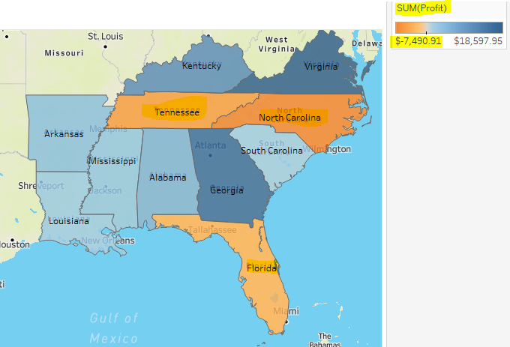
Find out the name of some state which has negative profit
We know from the analysis in geographical map it is evident that
North Carolina($ -7,490.91) , Tenessee($ -5.341.69) , Florida($ -3,399.30) has the negative profit

Slide 4
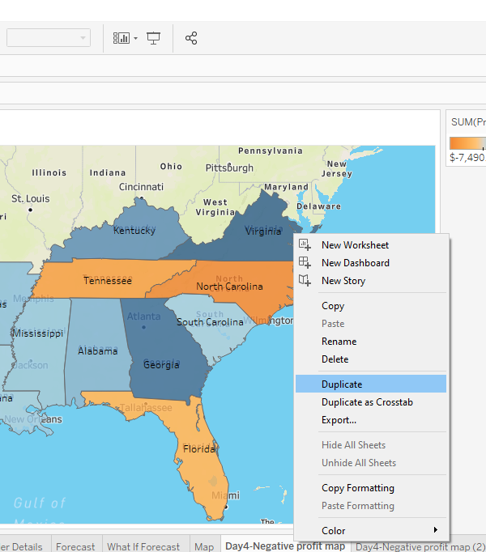
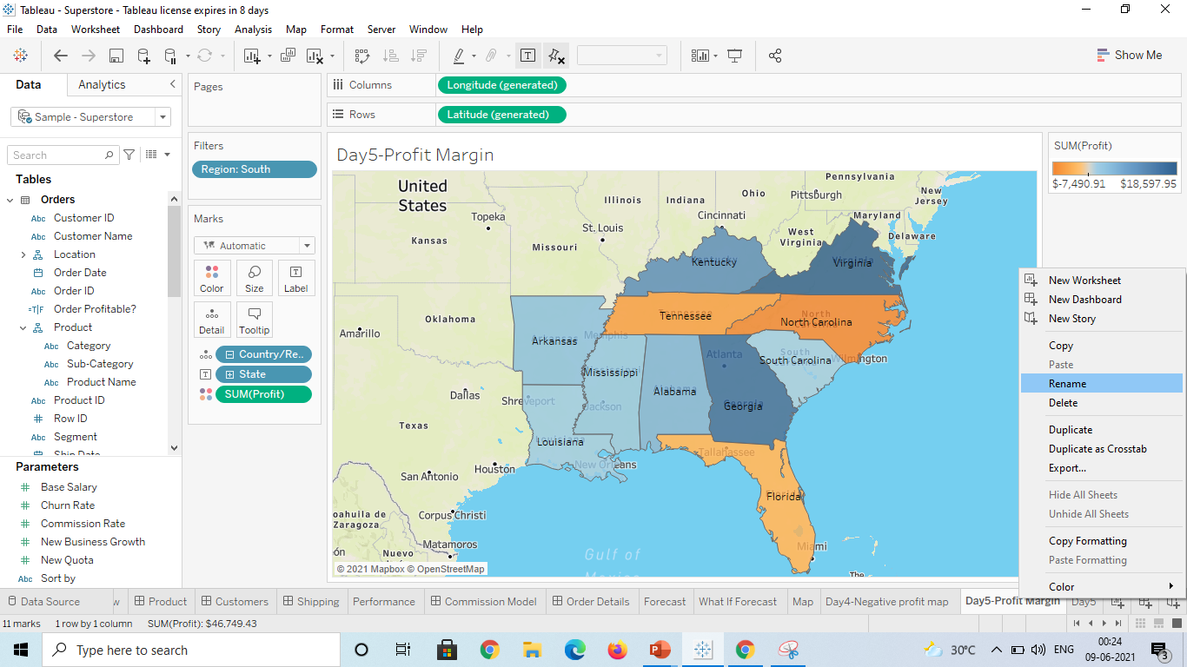
Duplicate the profit map and rename as negative profit map
Step1:
Right click on the Day4-Negative profit tab and select duplicate option and select rename the new tab as Day5-profit margin

Slide 5
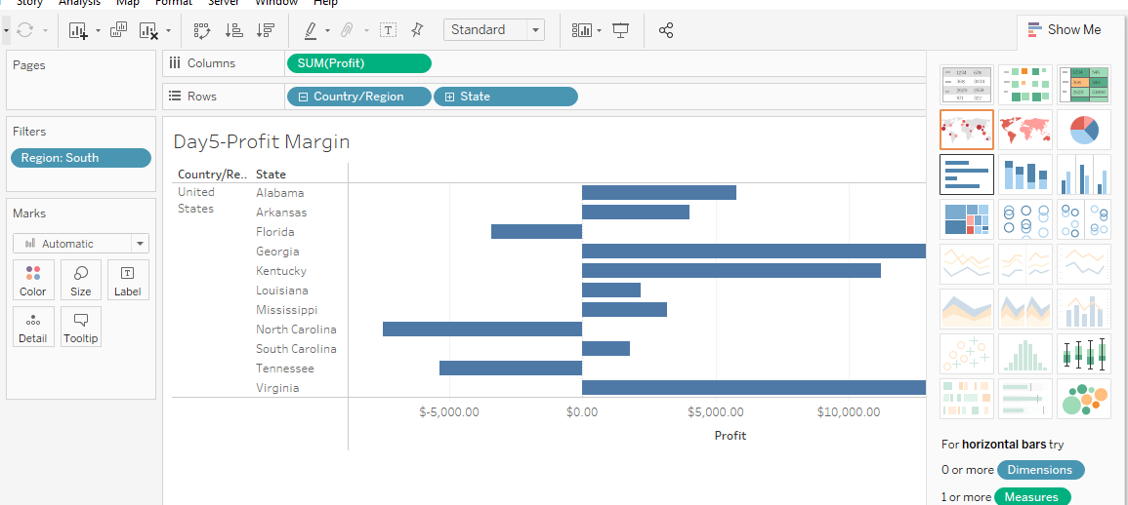
Represent the profit map in horizontal bar format
Step2: Select the Horizontal Bar option in Show Me where the visualization depicts the Negative profit and Positive profit

Slide 6
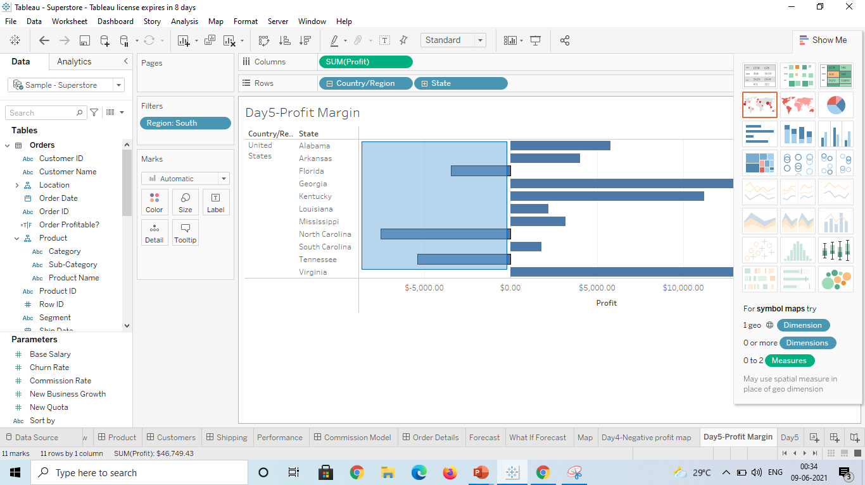
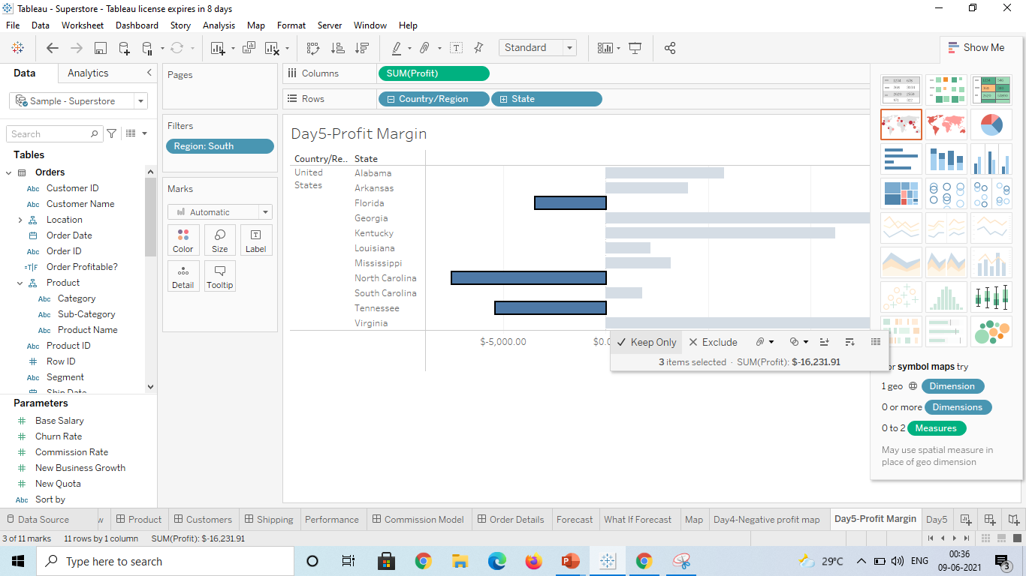
Show only the states having negative profit in the bar graph
Step3: Select the negative profit from the graph which will show pop option ‘Click→Keep Only’

Slide 7
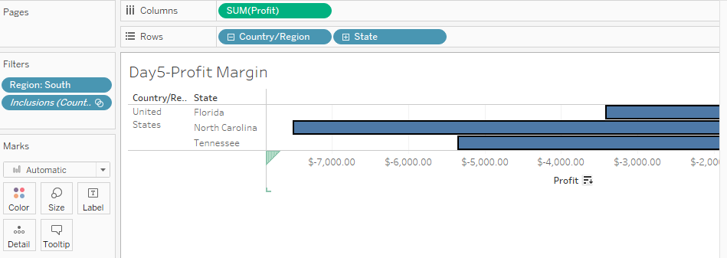
Below represents the visualization of the negative profit of the three countries
North Carolina($ -7,490.91) , Tenessee($ -5.341.69) , Florida($ -3,399.30)

Slide 8
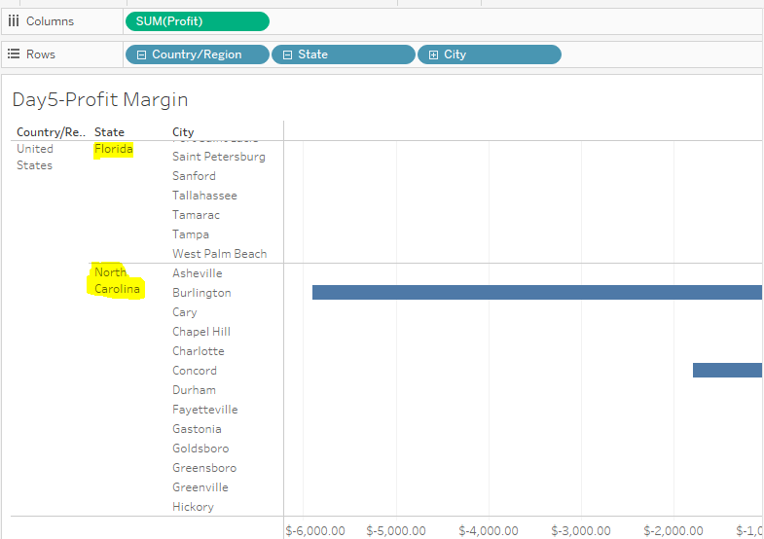
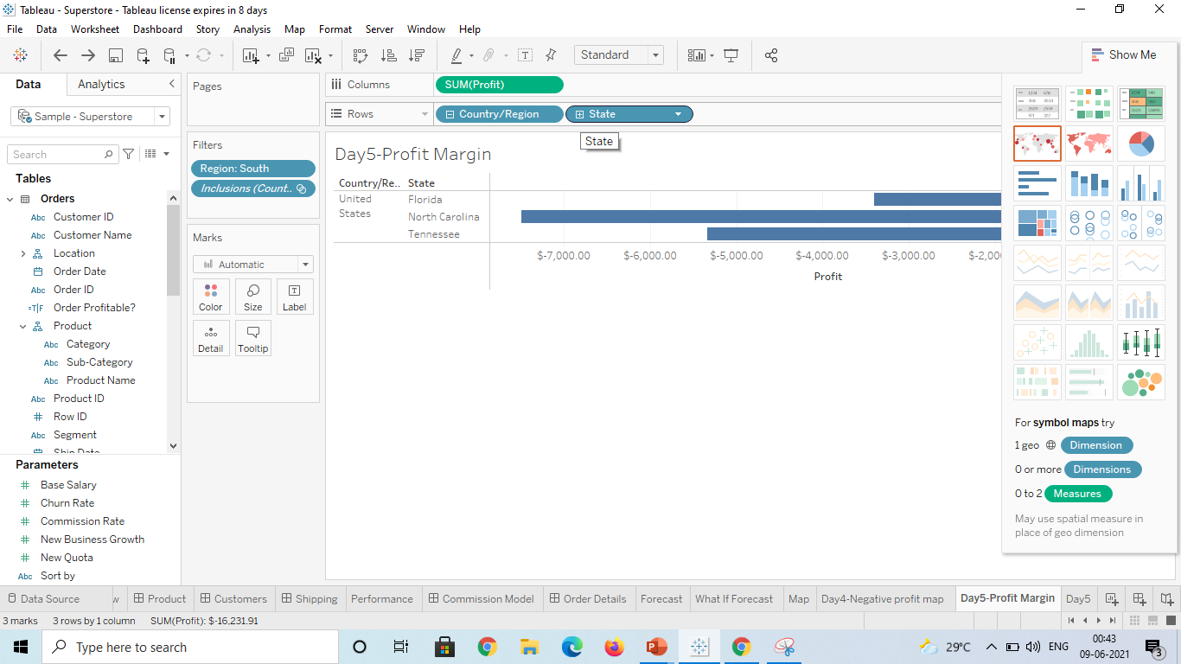
On the Rows shelf, click the plus icon on the State field to drill-down to the City level of detail.
Step4:Click the ‘+’ icon on State in Row shelf
Below represents city wise categorization in 3 state

Slide 9
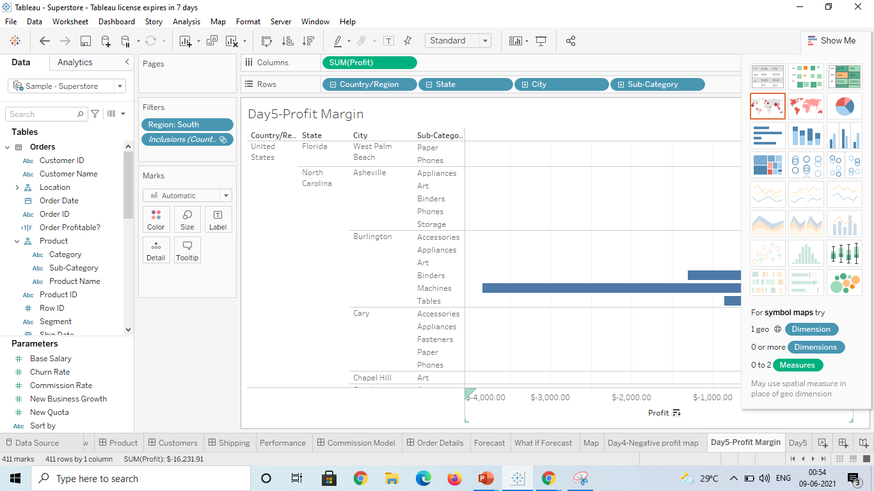
Show profit subcategory wise for all the states and city having negative profit.
Step5:
Drag the sub category unit from the tables and drop in rows shelf
Represents each sub category’s negative profit in each city on the state

Slide 10
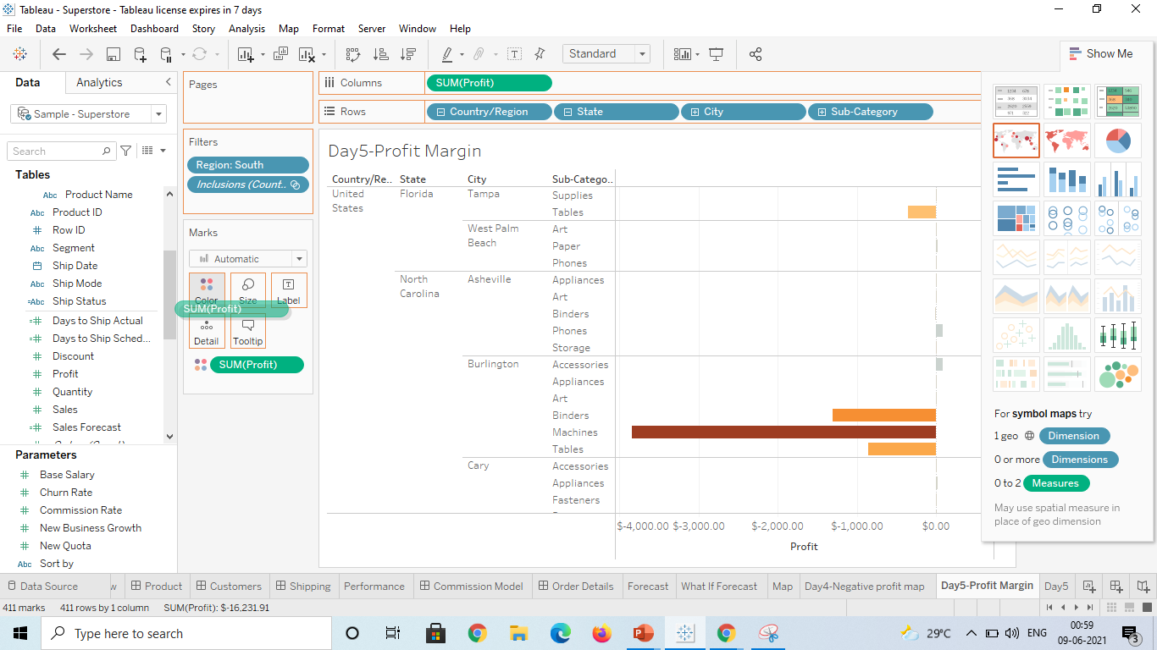
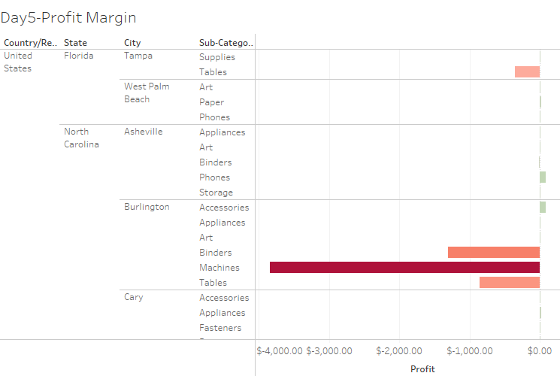
Show the profit in different colour.
Step 6: Drag and drop the SUM profit in color , changes the color on preferences

Slide 11
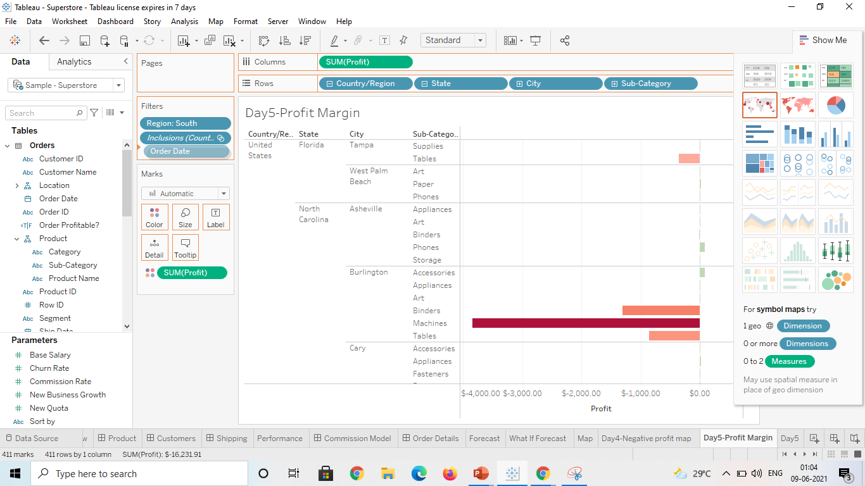
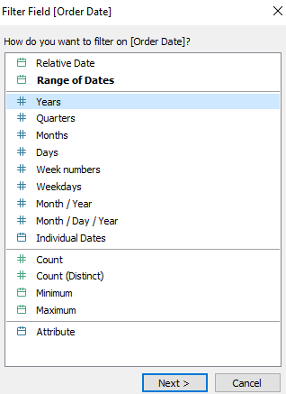
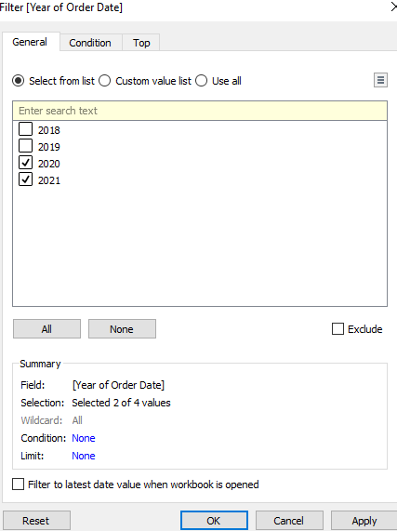
Check the profit in 2020 & 2021
Step7: Using Filter option drag the Order Date to ‘Filters shelf’ and click Year on Filter field → Next→Select check box 2020 , 2021 → click Ok

Slide 12
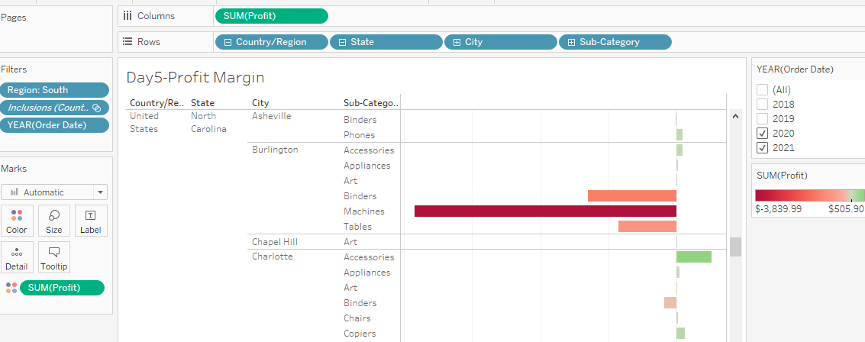
Below visualization shows the profit for the year 2020 & 2021

Slide 13
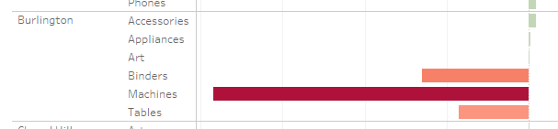
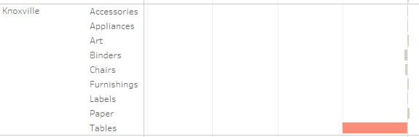
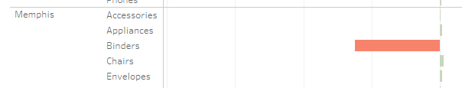
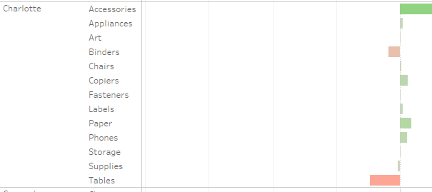
Find some meaningful information and suggest how can we increase the profit
From the analysis it is evident that maximum negative profit are found in Burlington city for Binders/Machines/Tables for the past 2 years hence production of these can be dropped on this city
We see tables and binders are again in negative profit for few of the cities like Knoxville , Memphis hence the sale of those can be reduced on the whole
Charlotte and Nashville city has the highest sub category with lesser –ve profit hence can be concentrated to add production more on these city

